Slide 1
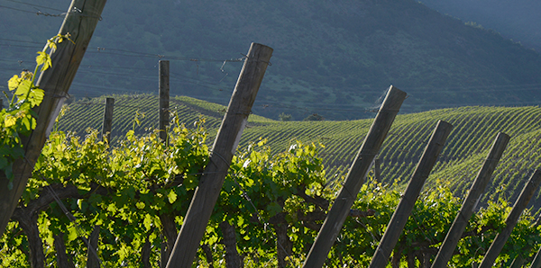
Más Unidos Plan Nacional de Asociatividad de Chile
Outline Curriculum

Slide 2
Table of contents
General Approach
The evolution of cooperatives
A Cooperative in a Food System
A Modern Agricultural Cooperative
Capitalization & Finance

Slide 3
General Approach
1

Slide 4
General Approach
      Each module will have the same structure: Why? What? How? Where?
Why?: is explaining the objective and the target group of this module
What?: the core content of the module. For instance in the module regarding ‘a cooperative in a food system’, the concept of a food system will be explained (theory)
How?: is explaining ‘how’ items can be made applicable in the Chilean context. This chapter consists of key questions, tools and examples related to the content presented. The presentation will be short and simple (using bullets) to make it better accessible (practice); how cooperatives can transform to modern cooperatives?
Where?: is sharing additional content if people are more interested to read details on a specific topic and links/ documents for further reading.

Slide 5
Modules
      Overview Outline Curriculum
The cooperative curriculum will consists of the following four modules:
  The evolution of cooperatives
  A Cooperatives in a Food System
  A Modern Agricultural Cooperative
  Capitalization & Finance
  The modules will be enriched with examples based on the following template:
    Topic
    Introduction
    Case description
    Effects
    Applicability to Chile

Slide 6
The Evolution of Cooperatives
2

Slide 7
The Evolution of Cooperatives
      The evolution of Cooperatives
The economic importance of Cooperatives
What is the value of the cooperative business model?
Historical Roots of Cooperatives
  Consumer Cooperatives
  Credit Cooperatives
  Dairy Cooperatives in the Netherlands
Cooperatives in a changing world
  Cooperatives for rural development
  Cooperatives and inclusiveness

Slide 8
A Cooperative in a Food System
3

Slide 9
A Cooperative in a Food System
      See our current report: ‘a cooperative in a food system’; what?
Transitions & Food System = core module
Transitions:
  Scale & Scope
  Marketing & Innovation
  Sustainability & Digitalization
Food System:
Sustainability Enablers
Economic Enablers
Digital Enablers

Slide 10
A Cooperative in a Food System
      See our current report: ‘a cooperative in a food system’; how?
Sectoral & Regional Analysis (assessment methodology ‘food system’ thinking)
Global demand & supply features
The sector in Chile
The value chain analysis
The regional dynamics
  Main characteristics
  Main takeaways

Slide 11
A Modern Agricultural Cooperative
4

Slide 12
A Modern Agricultural Cooperative
      Cooperative Governance & Leadership; what?
Cooperative Strategy
Segmentation, Channels, Value Proposition
Price Mechanism – Supply & Demand
Position in the value chain/ food system
Growth Strategy
Marketing & Innovation Strategies for Cooperatives
Collaborative Strategies
Governance Structures in Modern Cooperatives
Basic Governance Structures
Leadership & Management
Multi-Purpose Cooperatives
Innovation in Internal Governance

Slide 13
Cooperative Governance & Leadership
      Cooperative Governance & Leadership; what?
Member-Cooperative Relationship
  Services to members
  The need for collective action – the reasons for joining a cooperative
  Transaction, Ownership, Control & Community
  Member-Base: youth, aging farmers, lack of trust
Cooperative Principles
  ICA Principles
  Business Principle:
    Self-Financing
    Delivery Obligations
    Serve at Cost
    Proportionality

Slide 14
Cooperative Governance & Leadership
      Cooperative Governance & Leadership; how?
Business Plan
Business Plan Modern Cooperatives
  Structure Business Plan
  Specific items related to the cooperative structure (all items are addressed in the aforementioned curriculum)

Slide 15
Capitalization & Finance
5

Slide 16
Capitalization & Finance
      Capitalization & Finance; what?
Risk-Bearing Capital
  Risk-Bearing Capital – a prerequisite to become bankable and sustainable
  Principles of Self-Financing
  Capitalization & Zero-Loss Policy
  Advanced Capitalization Opportunities related to members
  Advanced Capitalization Opportunities not related to memebers
Finance Structures
  Basic finance Structures
  Blended Finance Structures
Credit Assessment
  General Credit Assessment
  How to assess an agricultural cooperative
  The different key assessment features of a cooperative

